Slide 1


Azure Databricks
Exploring Data Engineering
Maruti Makwana

Slide 2
Optimization Techniques
Ingestion optimization
Disk partitioning
Predicate pushdown
Bucketing
Z-ordering

Slide 3
Ingestion optimization
Understanding how Apache Spark ingests data can…
...help us understand what is happening under the hood
...making debugging and tuning easier
The first major concept in ingestion is Initial partition size is governed by four main factors:
The number of cores in your cluster (or rather it’s default parallelism)
The estimated size of the dataset
The configuration value of spark.sql.files.maxPartitionBytes
The default value is 128 MB
Governs the maximum size of a partition
The configuration value of spark.sql.files.openCostInBytes
The default value is 4 MB
The “extra” MBs of overhead padded to each file’s size the Spark-Partition

Slide 4
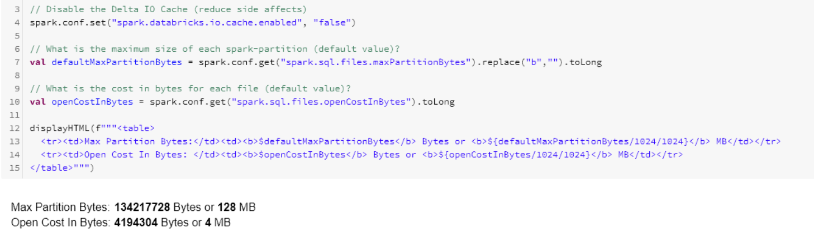
Here we just demonstaring that maxpartitionByte is 128 MB and Open Cost In Bytes is 4 mb

Slide 5
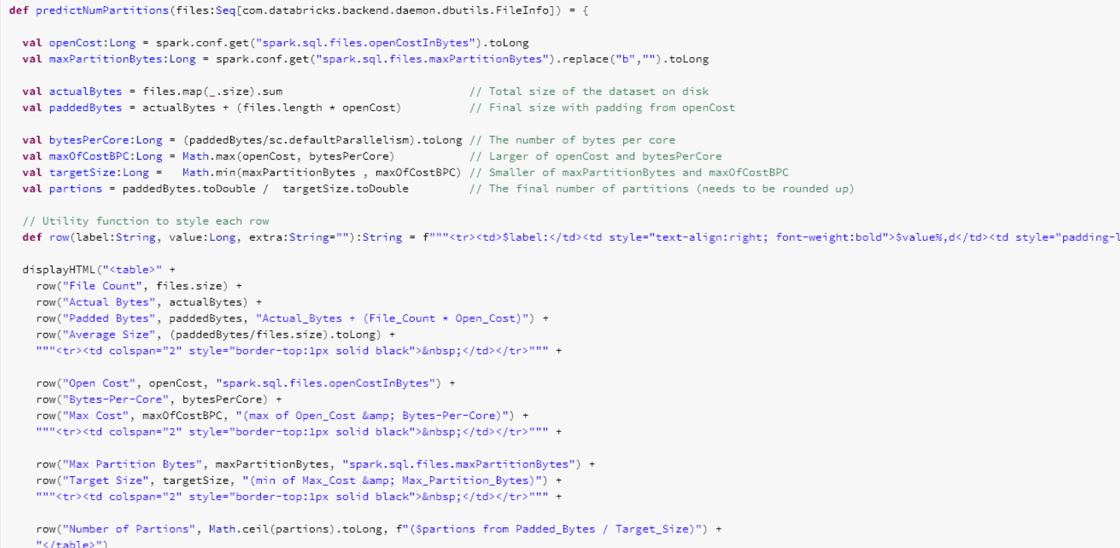
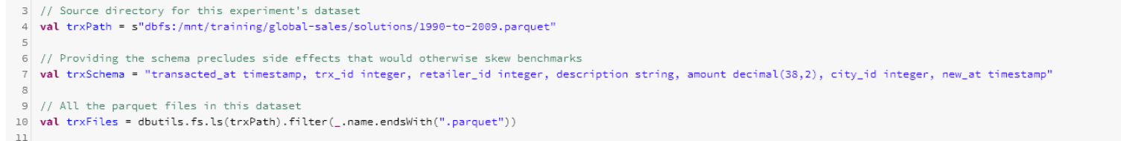
Here we break down the algorithm that apache spark is using to estimate how many partitions the dataset will have upon ingestion

Slide 6
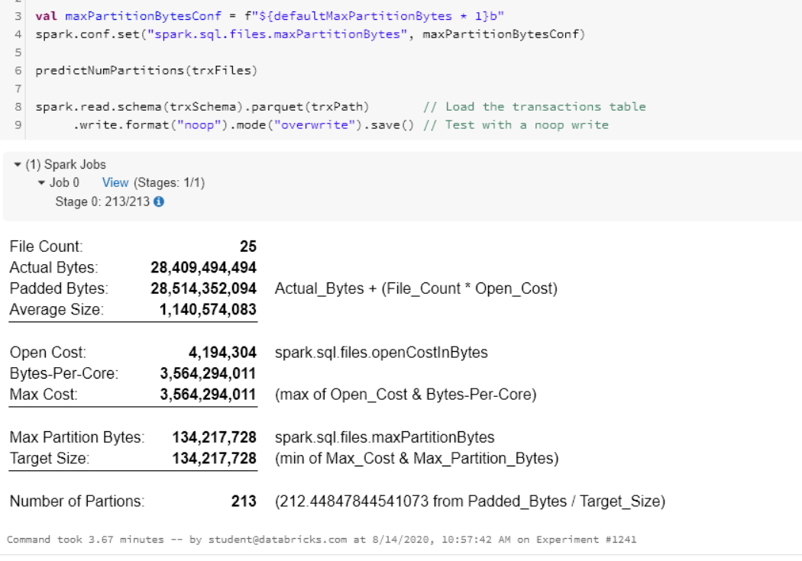
Here we will test with different MaxPartitionBytes
Scenario 1 : 1x

Slide 7
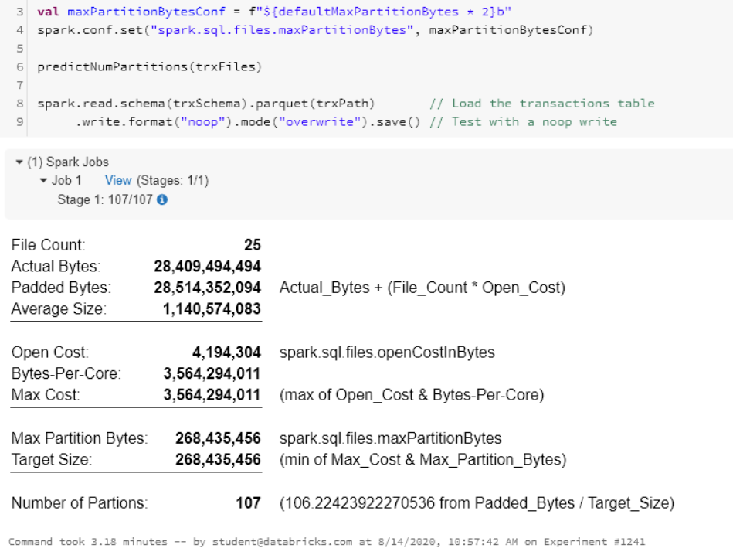
Scenario 2 : 2x

Slide 8
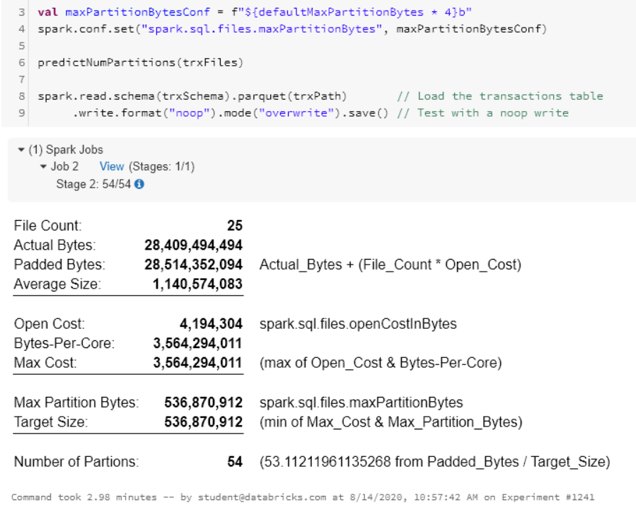
Scenario 3 : 4x

Slide 9
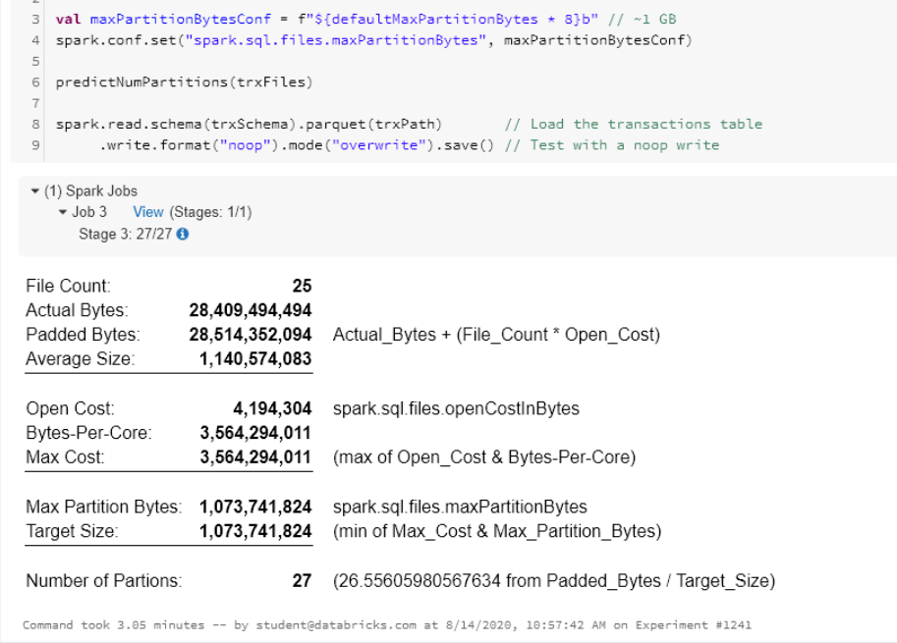
Scenario 4 : 8x

Slide 10
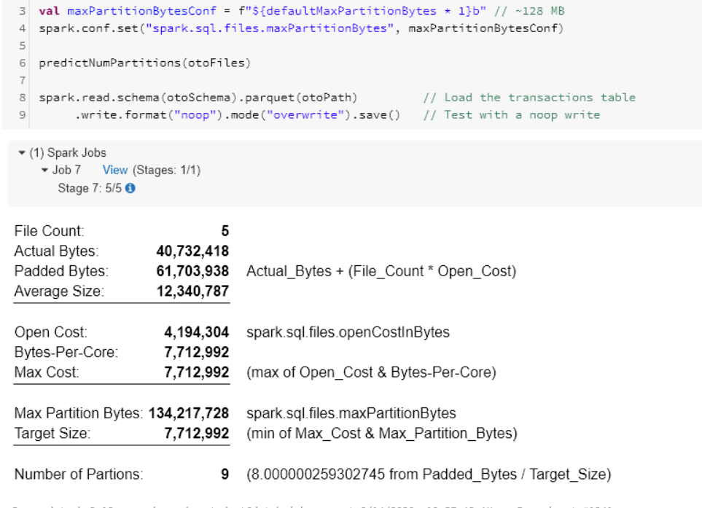
Ingesting small files
Here we are ingesting very small files, around 40 mb and each files is 8 mb
Here the 5 files are smaller than than deafult level of parallelism which is 8 .So there is no reason to split them or modify in any way

Slide 11
Experimental result:
There is a marginal performance increase as maxPartitionBytes increases
Presumably from a reduction in IO & more efficient tasks
A linear performance gain is not seen as maxPartitionBytes is increased

Slide 12


One scenarion where you may want to configure maxPartitionBytes:
When you ingest the data, by deafult data comes in 128 mb but if you want the 1gb part files in disk,then we have to
Repartition the files that would result in the shuffle operation
Read data in with 1gb spark partition. That case we dont have to repartition the file while storing into disk
Set maxPartitionBytes = 1GB

Slide 13

Here we calculate the maxPartitiobytes to avoide the scenario where cluster not properly being utilized
Lets say there are 8 cores and dataset is split into 9 partitions
When i read in the data,
If it takes a minutes per partition then i am gonna take 1 minutes to process first 8 partitions and wait up until
the task is freed up, take another minute to process the ninth partition
i.e i am taking 2 minutes for what can be done in 1 minutes
So with the help of some algorithm i can tweak the maxpartitionbyte setting so that i can bring back the partitions
from 9 to 8
i.e i can process everything in the single iteration
Note : i would not be bothered if task takes around 1 mins to complete, but in case if the task is taking 30 mins to
Complete then thats the significant performance hit

Slide 14
Disk Partitioning
Spark writers allow for data to be partitioned on disk with PartitionBy.
Some queries can run 50 to 100 times faster on a partitioned data lake, so partitioning is vital for certain queries.
Disk-partitioning applies to partitions of data on disk
Disk-partitioning uses a special directory structure to aggregate like records together
Spark can push a predicate down to the file scanner
Only those directories that match the predicate are read in
Works for Delta, Parquet, ORC, CSV, JSON and many more

Slide 15
Consider this dataset which is not partitioned:
.../2011-to-2018-100gb.delta/
.../part-00000-dde3cb66-4cc6-4cdd-8d97-a7b5733e4130-c000.snappy.parquet
.../part-00001-187cc51d-01ae-421a-81ea-ca639804474c-c000.snappy.parquet
.../part-00002-14486581-5d4b-46ec-81a8-c0eb464df22a-c000.snappy.parquet
.../part-00003-3bdee346-69c4-4304-b870-c14a2493fb3d-c000.snappy.parquet
.../part-00004-9a82b515-723b-4df5-ba15-eb0722073b43-c000.snappy.parquet
.../part-00005-b8154400-3be1-4a54-91cb-79e022637199-c000.snappy.parquet
This directory contain all the
Records for the year 2012
Consider this exact same dataset which is partitioned by year:
.../p_transacted_year=2011/
.../part-00000-2c0408a7-d267-4dae-b055-8d1c178ee53f.c000.snappy.parquet .../part-00001-e2834499-9b82-4b00-afc0-601e14ffd41f.c000.snappy.parquet .../p_transacted_year=2012/ .../part-00000-1e59347e-18f9-4a08-9e58-b0542212b1dc.c000.snappy.parquet .../part-00001-58e35c69-ebd1-454e-aa6d-142b135f3d74.c000.snappy.parquet .../p_transacted_year=2013/
.../part-00000-8f3d8071-c746-45c5-8793-0aceed9b804d.c000.snappy.parquet
.../part-00001-925d23e1-e17d-44c1-a9e8-226a1b6cf93e.c000.snappy.parquet
Here the data is partitioned by key and value pair. In the above example p_transacted_year is the column
Name and 2012 is the value

Slide 16
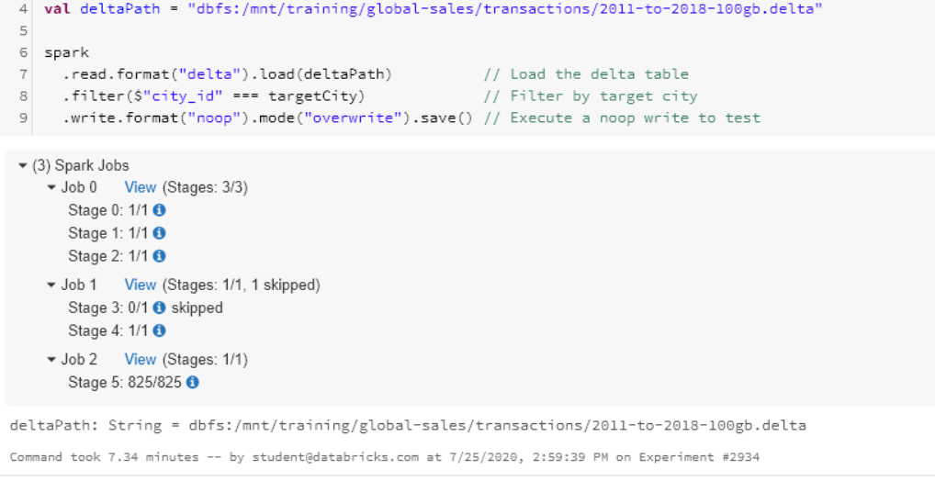
Not optimized for any kind of filtering
Set targetCity == 12345
It takes around 825 task to complete the process and takes around 7.34 mins

Slide 17
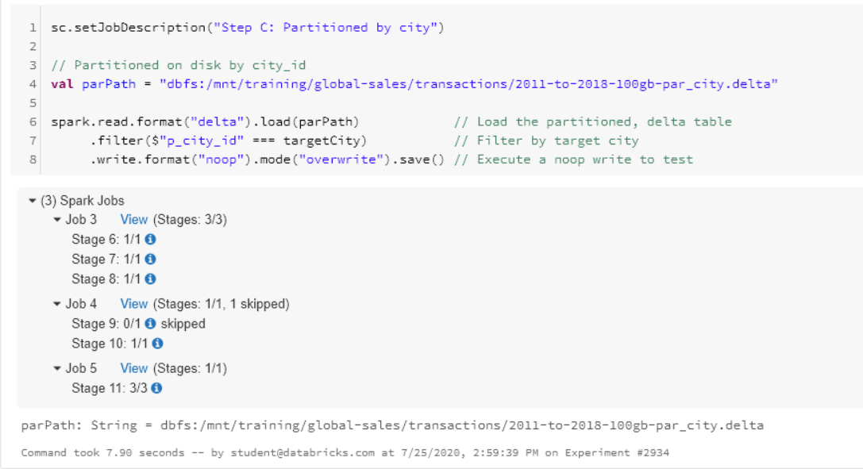
Now we will compare it with directory which is partitioned by city.
Here the source path is the same only difference is that its partitioned by city
Execution takes around 7 sec thats a significant difference and the performance gain is astronomical.

Slide 18
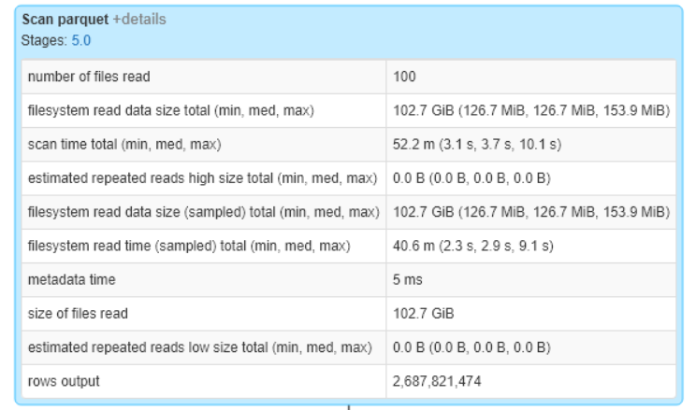
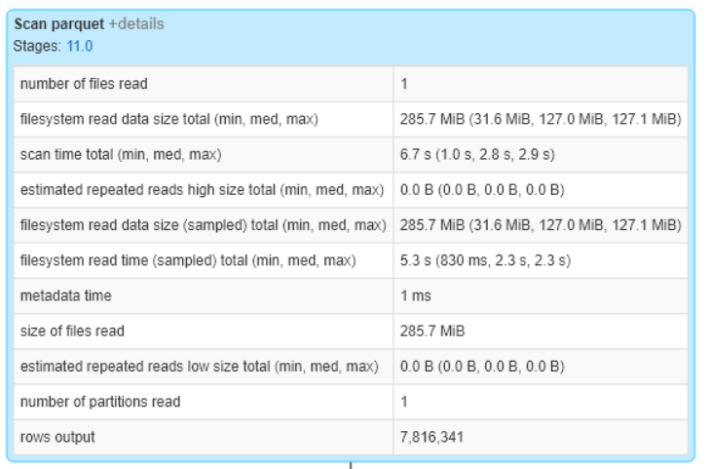
Now lets look into the SparkUI
Baseline
Disk partitioning

Slide 19
Disk-Partitioning Warnings
Over partitioning can lead to Tiny Files.
Consider a 1024 MB part-file now partitioned by hour
This will produce 24 part-files, each one ~42 MB (1024 / 24)
Over partitioning can result in excessive directory scanning by creating a highly nested structure

Slide 20
Repartition and coalesce functions
Repartition() function is widely used and defined as to increase or decrease the Resilient Distributed Dataframe(RDD) or DataFrame partitions.
The Coalesce() widely used a dis defined to only decrease the number of the partitions efficiently. We can use COALESCE function to replace the NULL value in any column with the user provided value. Unlike for regular functions where all arguments are evaluated before invoking the function, coalesce evaluates arguments left to right until a non-null value is found. If all arguments are NULL , the result is NULL
Repartition triggers a full shuffle of data and distributes the data evenly over the number of partitions and can be used to increase and decrease the partition count. Coalesce is typically used for reducing the number of partitions and does not require a shuffle. According to the inline documentation of coalesce you can use coalesce to increase the number of partitions but you must set the shuffle argument to true. Please note that unlike repartition, coalesce does not guarantee equal partitions.

Slide 21
Predicate pushdown
The Predicate Pushdown is the basis for most of the reduction strategies
A Predicate is simply a condition applied to records read in by a Spark job
More specifically, it’s employing discrete schemas, filter(..), where(..), select(), and drop() transformation (to name a few) that are then pushed down to the underlying data store
The predicate is applied as early as possible
If applied early early enough (e.g. as the first transformation), then records can be excluded and never pulled into the executor
If applied late, all records might be pulled into the executor, after which non-matching records are discarded

Slide 22
Columnar Data Formats
It is another way by which we can implement predicate pushdown.
Filters are not the only “predicate” that can be pushed down
Column selection can also be pushed down
With a database like PostgreSQL, this is done with a SELECT statement
For files, we require a Columnar File Format
What constitutes a “Columnar File Format?”
Textbook Definition: Data is stored by column, not by row
Examples include Delta, Parquet, and ORC
Compared to Row-Based File formats that store data by row
Examples include CSV, TSV, JSON, and AVRO

Slide 23
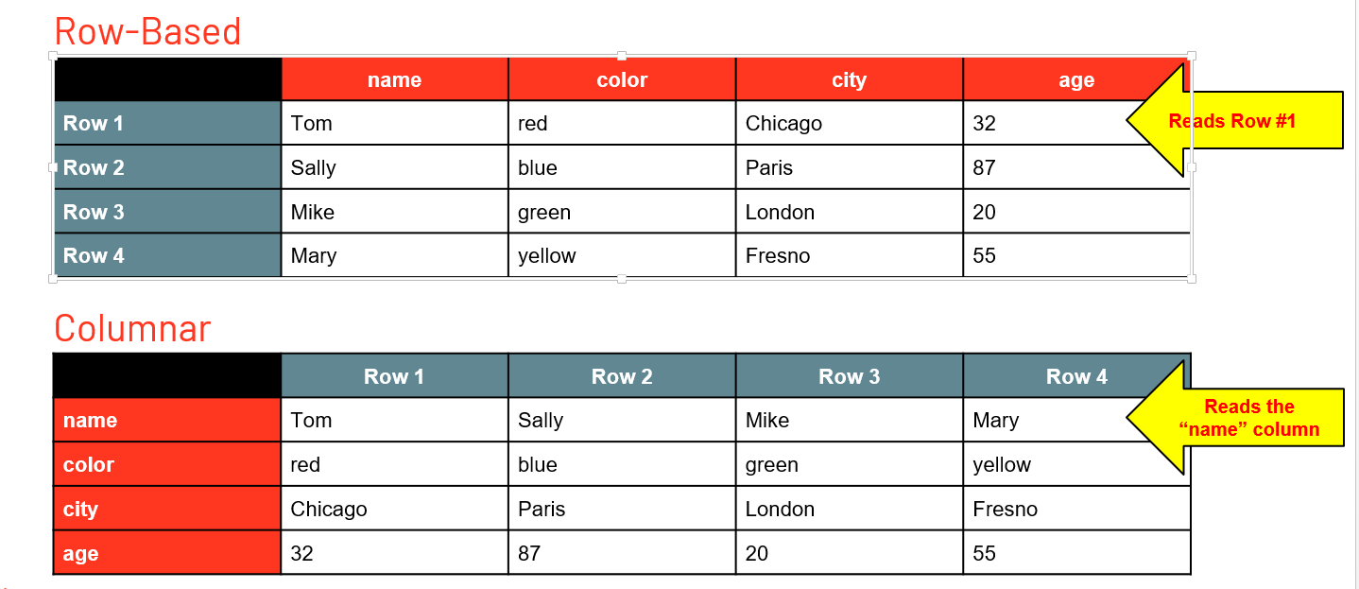
An Example: Columnar vs Row-Based

Slide 24
By reading in only specific columns, Spark can reduce the overall IO
Consider the schema from the previous example: name:STRING, color:STRING, city:STRING, age:INTEGER
And the following SQL Query: SELECT name, age FROM whatever
Only the qualifying columns (name & age) are returned
Compare this to JSON and CSV in which the entire row must be read into the executor before unused columns can be discarded

Slide 25
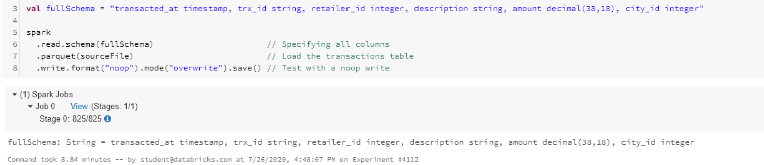
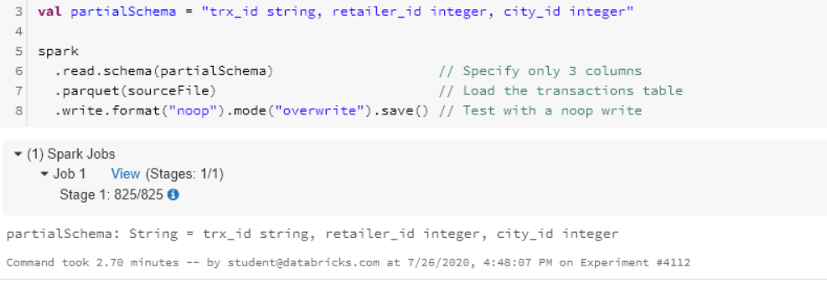
Here we read up the file from the source and we sepecify the full schema and its coming around 8.84 mins
read up partial schema

Slide 26
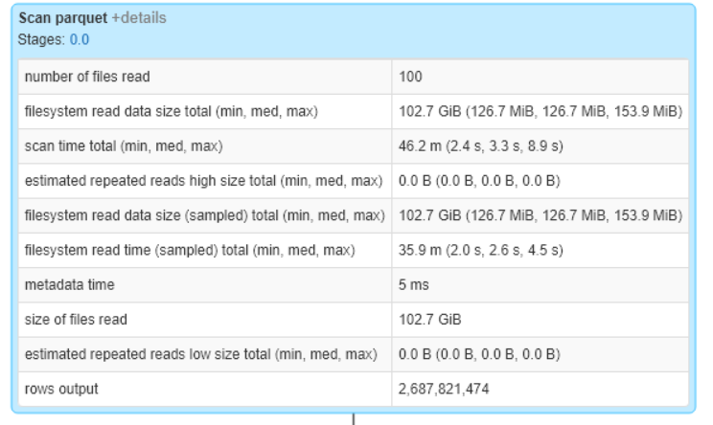
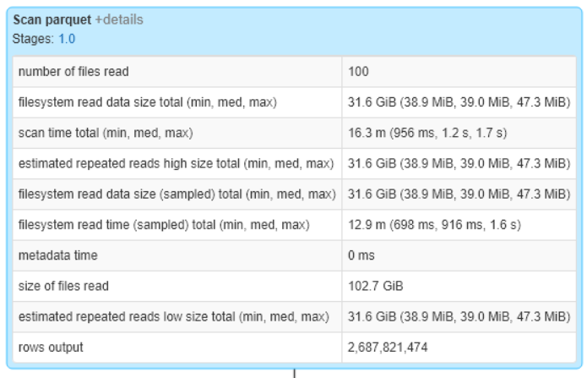
Lets compare scan time
Full schema read
Partial schema read

Slide 27
Bucketing
Bucketing aims to minimize the effects of a SortMergeJoin by eliminating expensive shuffle operation
Bucketing pre-shuffle the data so that data is located in the specified disk or part file
It gurantees that for perticular city id all records are in the same part file and they are going into the same executor so completely eliminating the exchange operation
This is done by pre-shuffling the data by column C into N bucketsIt a
It enables predicate push downs by means of the data structure
The extra knowledge about the bucket, where the part files are located and indexes of each of the part files. That means we can employ predicatae pushdown againt meta store and ultimately read in less files
Note : In order to shuffeling strategy to work, both the tables must have the same number of buckets to skip the exchange

Slide 28
Baseline :

Slide 29
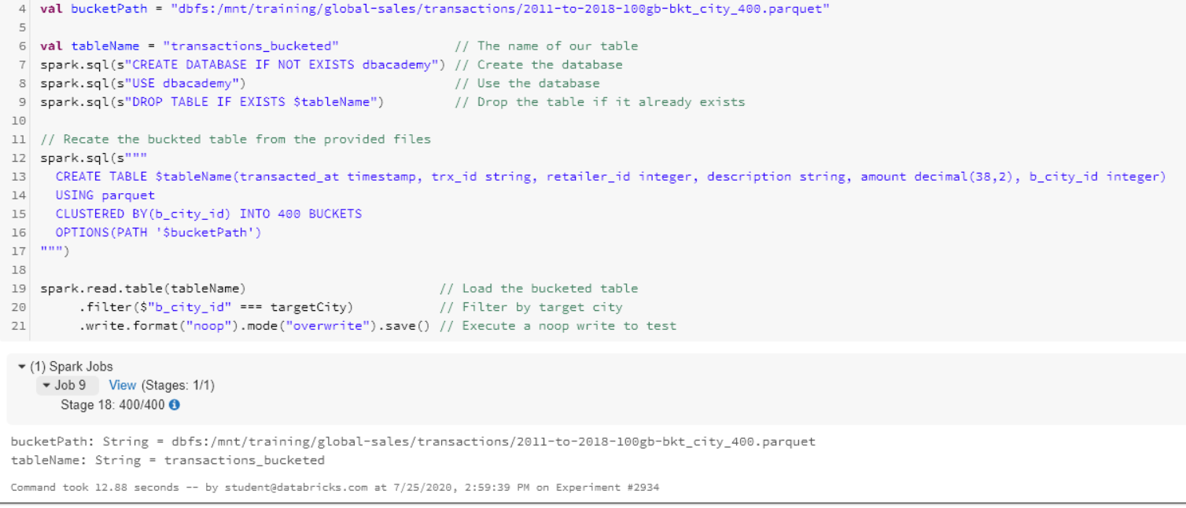
Bucketing strateagy for predicate push down
Bucketed data has to be registered as a table metastore
Here we are registering bucketed path as registered table and clustering them into 400 buckets

Slide 30
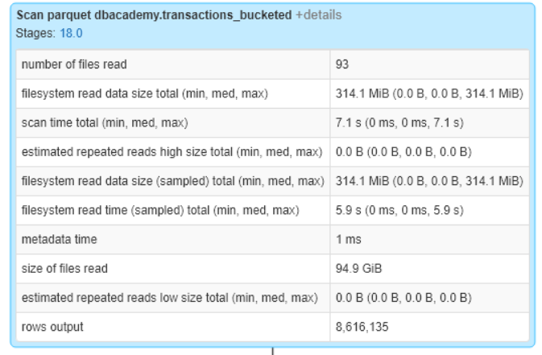
Baseline
Bucketing

Slide 31
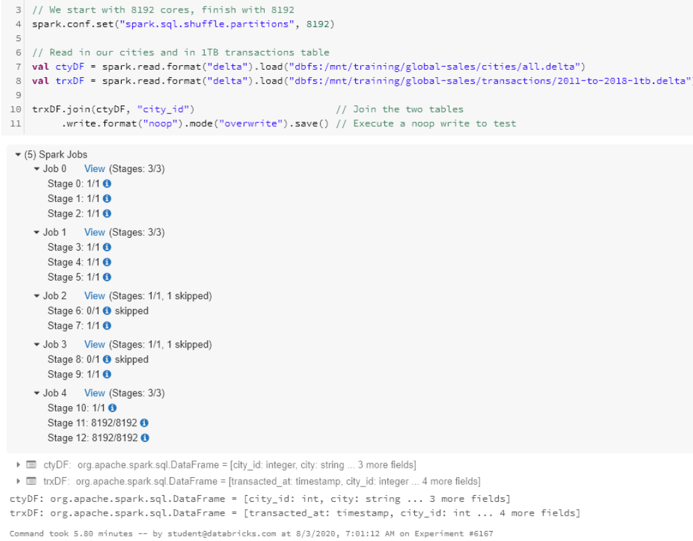
Bucketed Join
Baseline:

Slide 32
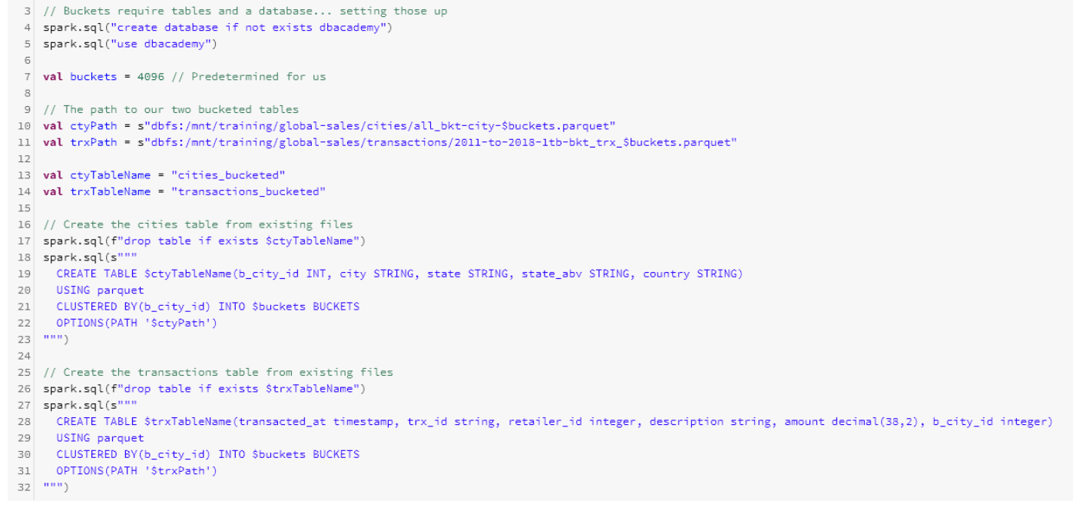
Setting up buckets

Slide 33
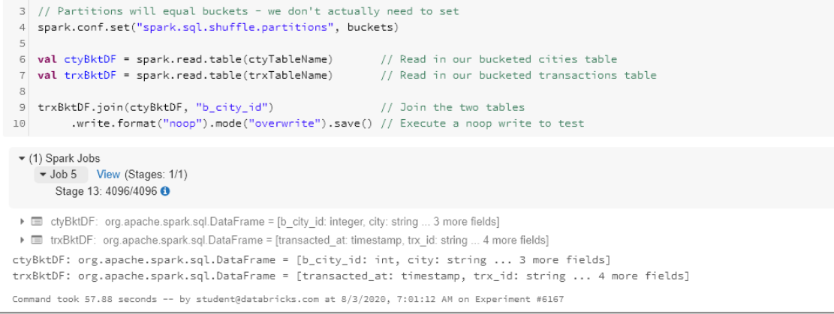
Next we will look at the joining strategy and it took around 57 seconds. Thats phenomonal performance

Slide 34
Z-ordering
Z-Ordering is a technique to colocate related information in the same set of files. This co-locality is automatically used by Delta Lake on Databricks data-skipping algorithms to dramatically reduce the amount of data that needs to be read. To Z-Order data , you specify the columns to order on in the ZORDER BY clause:
If you expect a column to be commonly used in query predicates and if that column has high cardinality
(that is, a large number of distinct values), then use ZORDER BY.
Drastically reduces the scan time for highly selective queries
- filtering 1 record from billion transactions
Supports binary comparison operators such as StartsWith, Like,In <list> as well as AND, OR and NOT operations and others
Note: This features is only available in databrikcs with Delta format

Slide 35
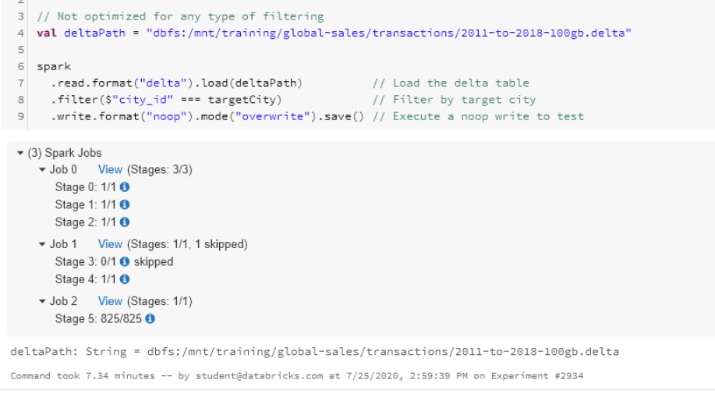
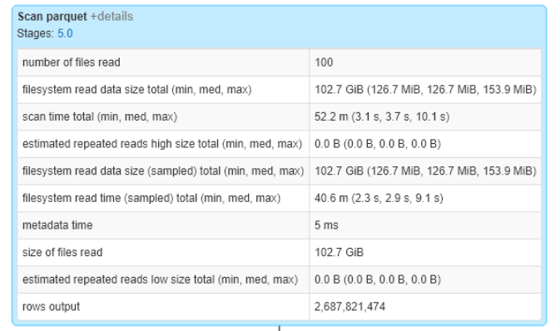
Establish the baseline:

Slide 36
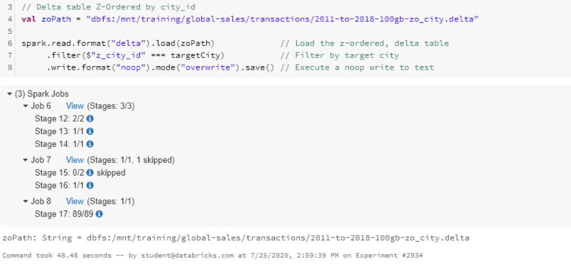
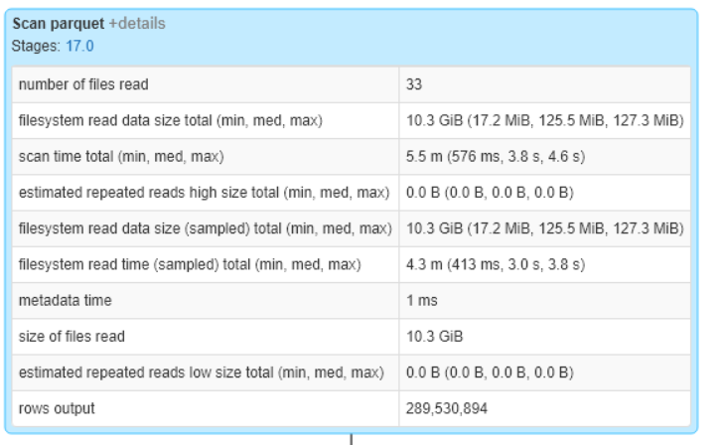
Here we read up the delta table which is Z-Ordered by city id and it takes around 48 second to execute the code

Slide 37
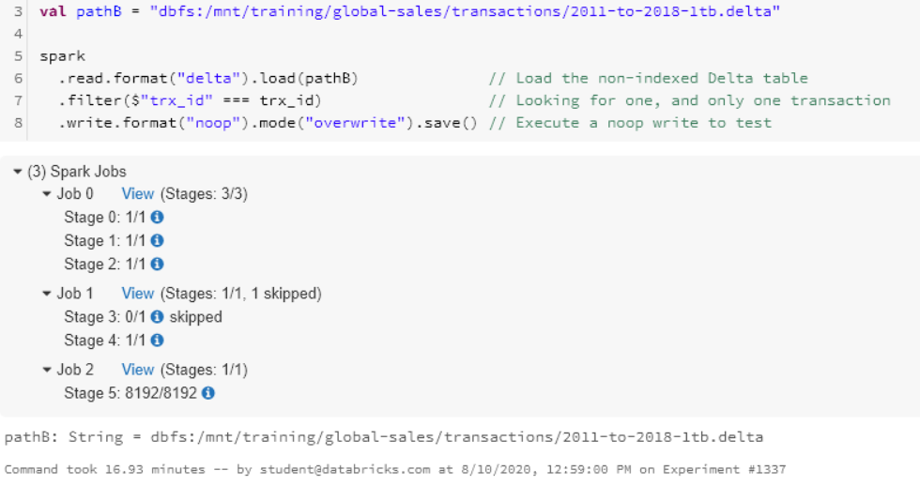
Querying 1 record from 1 TB dataset
Here we will load up the dataset which is not optimized and look for specfic transaction id. It took around 17 mins

Slide 38
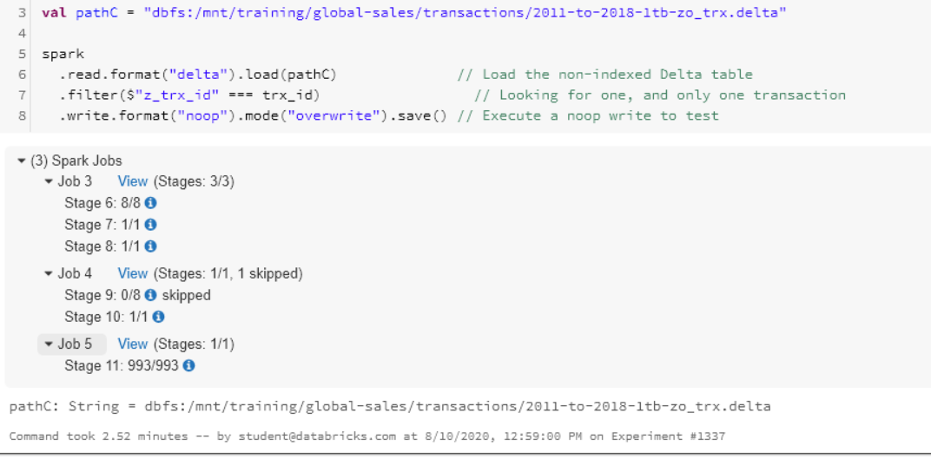
In this example we will load up the delta table which is z ordered on transaction id column.
It takes around 2.52 which is significantly faster than 16mins. Thats the huge performance increase for finding out 1 record
Out of 24 billion records

